Slide 1
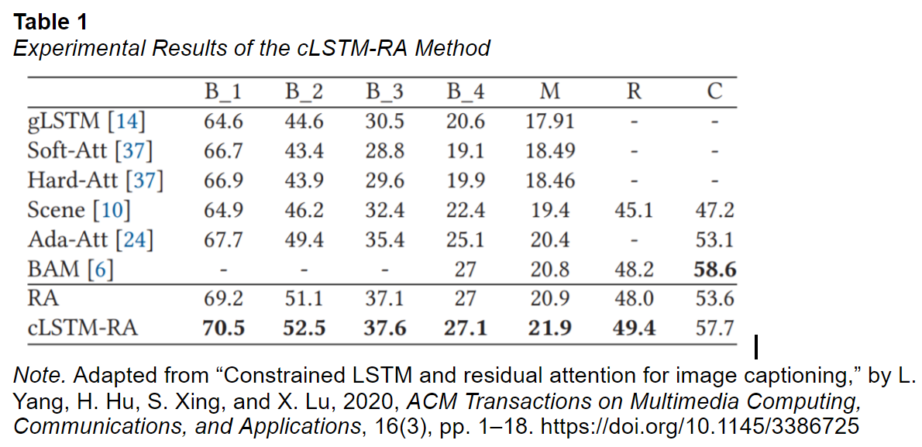
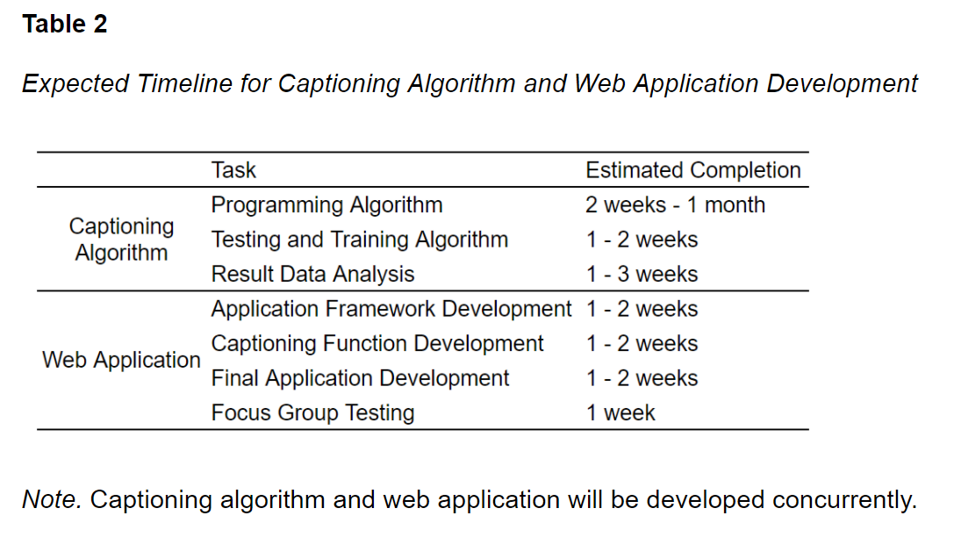
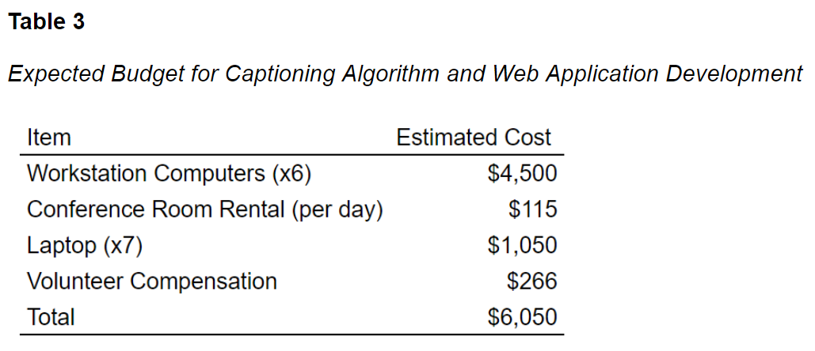
ENGR 361 Research Proposal: A Machine Learning Approach to Automatic Closed Captioning​
Lionel Quintanilla, Andrew De La Rosa, Pouya Tavakoli, Brian Tran, Matthew Zaldana | Professor Maryam Qudrat | California State University, Long Beach​
Introduction
Procedure
Results
Research Question: Develop and test an application that can automatically generate closed captions using machine learning techniques​
Background/Significance:​
Certain content requires closed captions (FCC, 2021). ​
Many providers create captions automatically with Automatic Speech Recognition (Google Cloud, 2021). ​
ASR does not produce particularly accurate closed captions, only 60% to 70% accurate (Bond, 2014).​
Inaccurate captions carry legal liability; NAD sued Harvard and MIT in 2015 for inaccurate captions (Rosenblum, 2015).​
Providing accurate captions protects from liability and fines.​
Neural networks in captioning show promising results. cLSTM-RA scored a 70.5 on the BLEU natural language test (Yang et al., 2020).​
Analysis Plan:
Aim 1: Compare the results of each technique using the four most common machine learning tests to determine the accuracy of the captions.
Accuracy of produced text (AT)
Visual quality of the text on-screen (VQ)
Quality of descriptive language (QL)
Scored on a scale from 0 to 1.
Aim 2: Measure the visual appeal of the text generated on screen, as well as the quality of descriptive text for HoH/deaf people.
VQ is the average of scores received from those survey questions.
QL is the average of those scores.
Average score is around 0.5
An excellent score is 0.8 to 0.9
The survey also contains open response sections that gauge the overall experience
Design
Sample Size
Each algorithms runs ~16.5 minutes of video.
Captions will be saved for analysis.
Results will be tested for accuracy and readability.
Each focus group will watch ~5 minutes of captioned video.
Will answer a questionnaire on readability and experience.
Using the MSCOCO and Flickr30k dataset for sample videos.
MSCOC has 30,000 images with 5 captions each (Microsoft, 2021).
Flickr30k has 30,000 images with 158,000 captions (Plummer et al., 2015).
Setting
Protocol
Algorithms will be tested in an air-conditioned computer laboratory.
Study participants will be invited to multimedia room to watch videos and complete survey.
Each computer trains datasets for one 24-hour cycle. After the algorithm is trained, the automated AT metric tests are run once per algorithm.
There is a 15-minute time limit for completion of the survey, but the survey should take no more than 7 minutes to complete.
Conclusions
Aim1: Our goal is to provide a technique produces immediate improvement in accuracy over existing methods.
Results are analyzed using BLEU, which measures the accuracy of machine-generated text at a sentence level (Papineni et al., 2001)
We expect to score around 60 to 80 marks on natural-language tests
We desire to improves not only accuracy of, but also the grammar and vocabulary to make it easier to understand.
Aim 2: The expectation that the focus group will answer with at least a 3 on all the questions.
Computerized examinations can only go so far in measuring the effectiveness of our technique
Caption-captivating methods creates a strong connection between what the users’ eyes will see as well as the comprehension and understanding of the information.
References:
Benton, B. (2021, October 21). Workstation vs desktop computer: Which do you need?; Bond, L. (2019, June 3). Are Automatically Generated Captions and Transcripts Detrimental to Video SEO?; Burgstahler, S. (2018). Creating Video and Multimedia Products That Are Accessible to People with Sensory Impairments.; Federal Communications Commission. (2021, January 27). Closed Captioning on Television. Federal Communications Commission; Google Cloud. (2021). Speech-to-Text Basics; IBM Cloud Education. (2020, August 17). What Are Neural Networks?; Lavie, A., & Agarwal, A. (2007). Meteor: an automatic metric for MT evaluation with high levels of correlation with human judgments; Lin, C.-Y. (2004). ROUGE: A package for automatic evaluation of summaries; Microsoft. (2021). Common Objects in Context; Nam, S., Fels, D. I., & Chignell, M. H. (2020). Modeling closed captioning subjective quality assessment by deaf and hard of hearing viewers; National Institute of Deafness and Other Communication Disorders. (2021, March 25); Papineni, K., Roukos, S., Ward, T., & Zhu, W.-J. (2001). BLEU: A method for automatic evaluation of machine translation; Pavic, F., & Brkic, L. (2021). Methods of improving and optimizing react web-applications; Peerspace. (2021, October 23). How Much Does It Cost to Rent a Hotel Conference Room?; Pickard, J. (2021, November 11). The Best Cheap Chromebook Prices and deals in December 2021; Plummer, B. A., Wang, L., Cervantes, C. M., Caicedo, J. C., Hockenmaier, J., & Lazebnik, S. (2015). Flickr30k entities: Collecting region-to-phrase correspondences for richer image-to-sentence models; Rosenblum, H. A. (2015, February 12). NAD Sues Harvard and MIT for Discrimination in Public Online Content; Yang, L., Hu, H., Xing, S., & Lu, X. (2020). Constrained LSTM and residual attention for image captioning.

